Slide 1
MLflow in Azure Databricks
CS5304 – Big Data Services and MLOps

Slide 2
What is MLflow
MLflow is an open source platform for end-to-end machine learning operations.
Using MLflow, data scientists can:
  Track model training experiments;
  logging parameters, metrics, and other assets.
Machine learning engineers can use MLflow to :
  deploy and manage models,
  enable applications to consume the models and use them to inference predictions for new data.

Slide 3
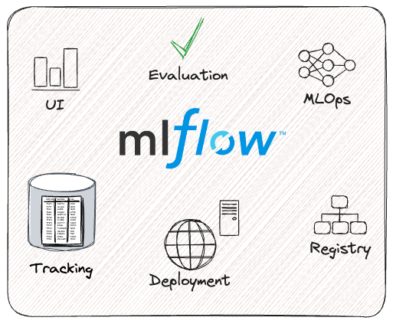
MLflow Components
Notes:
https://mlflow.org/docs/latest/
https://learn.microsoft.com/en-us/training/modules/mlflow-azure-databricks/2-capabilities-of-mlflow

Slide 4
MLflow Tracking
MLflow Tracking allows data scientists to work with experiments in which they process and analyze data or train machine learning models.
For each run in an experiment, a data scientist can log parameter values, versions of libraries used, model evaluation metrics, and generated output files; including images of data visualizations and model files.
This ability to log important details about experiment runs makes it possible to audit and compare the results of prior model training executions.

Slide 5
Concepts
Runs
  MLflow Tracking is organized around the concept of runs, which are executions of some piece of code, for example, a single python_train.py execution.
  Each run records metadata (various information about your run such as metrics, parameters, start and end times) and artifacts (output files from the run such as model weights, images, etc).
Experiments
  An experiment groups together runs for a specific task.

Slide 6
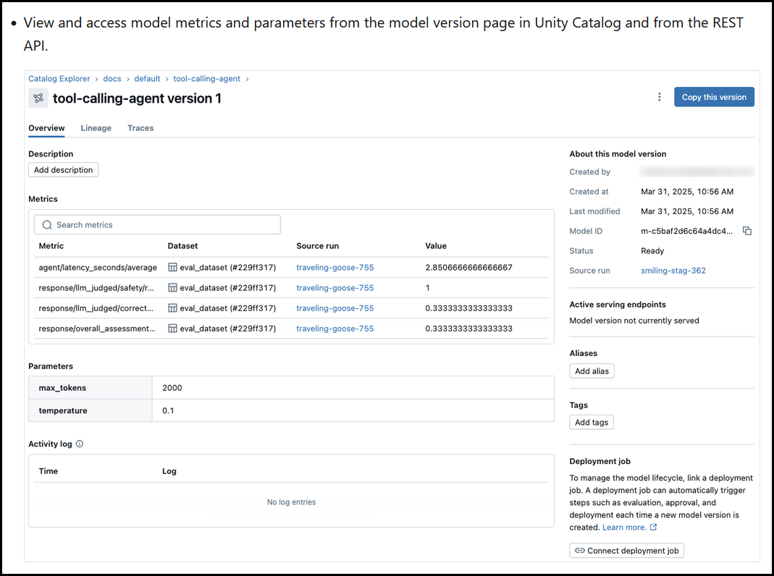
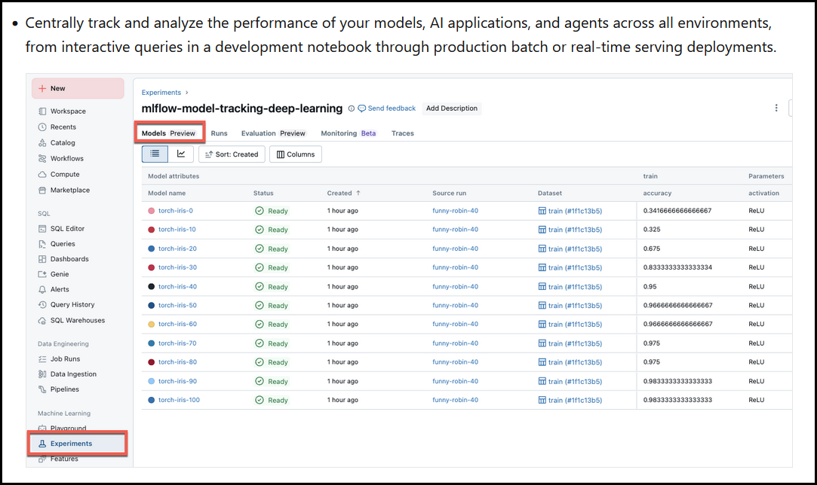
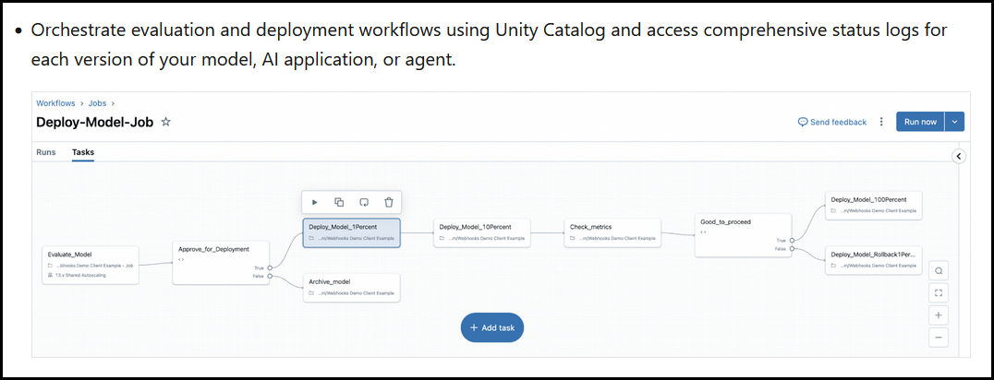
Azure Databricks Experiments Tracking

Slide 7
MLflow Projects
An MLflow Project is a way of packaging up code for consistent deployment and reproducibility of results.
MLflow supports several environments for projects, including the use of Conda and Docker to define consistent Python code execution environments.

Slide 8
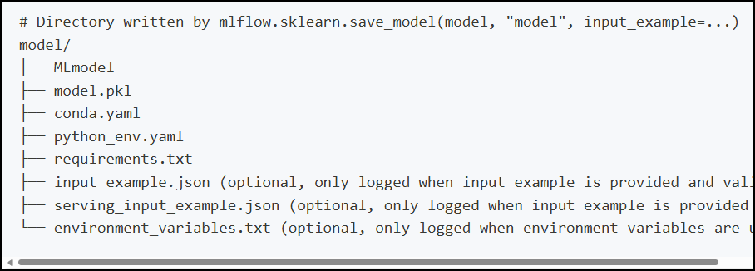
MLflow Models
MLflow offers a standardized format for packaging models for distribution.
MLflow Models are a standardized format for packaging machine learning models and generative AI agents. The standardized format ensures that models and agents can be used by downstream tools and workflows on Databricks.
The MLflow Model Registry allows registration of trained models. MLflow Models and MLflow Projects use the MLflow Model Registry to enable machine learning engineers to deploy and serve models for client applications to consume.
Notes:
https://mlflow.org/docs/latest/models.html

Slide 9
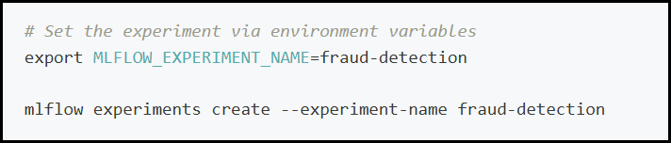
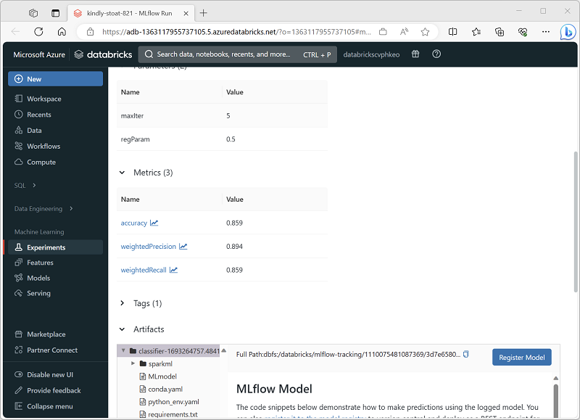
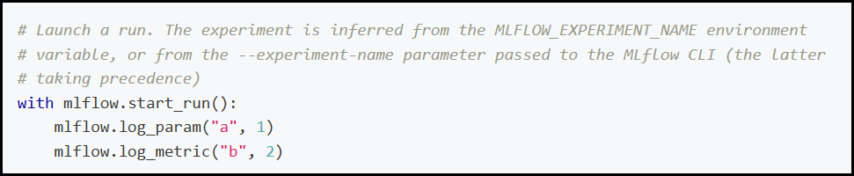
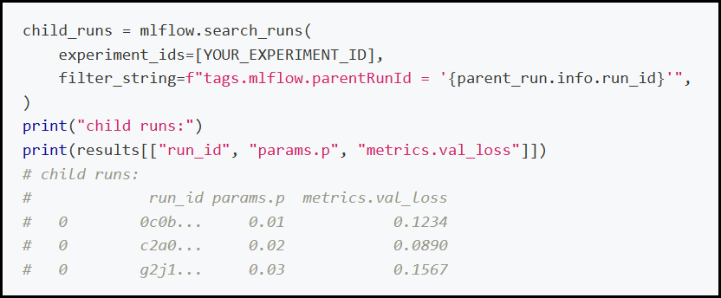
Running Experiments
Notes:
https://mlflow.org/docs/latest/tracking/tracking-api#organizing-runs-in-experiments

Slide 10
Register and serve models with MLflow
Model registration allows MLflow and Azure Databricks to keep track of models; which is important for two reasons:
  Registering a model allows you to serve the model for real-time, streaming, or batch inferencing.
  Registration makes the process of using a trained model easy, as now data scientists don't need to develop application code; the serving process builds that wrapper and exposes a REST API or method for batch scoring automatically.
  Registering a model allows you to create new versions of that model over time; giving you the opportunity to track model changes and even perform comparisons between different historical versions of models.
Notes:
https://learn.microsoft.com/en-us/training/modules/mlflow-azure-databricks/4-register-serve-models

Slide 11
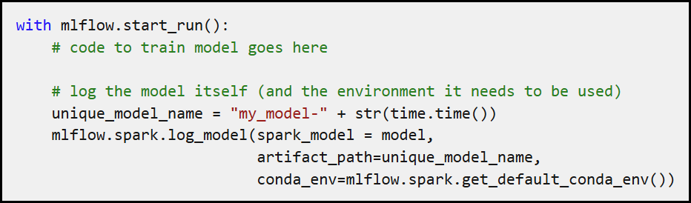
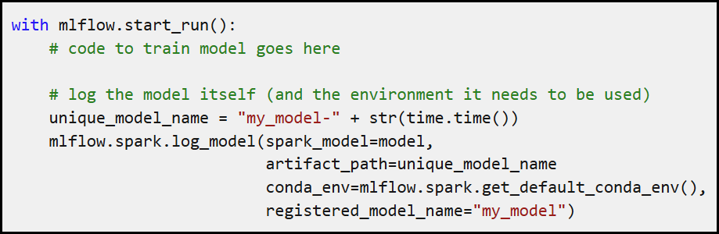
Registering a model
When you run an experiment to train a model, you can log the model itself as part of the experiment run, as shown here.
You can then select the option to register the model using the user interface in the experiment viewer.
Alternatively, if you want to register the model without reviewing the metrics in the run, you can include the registered_model_name parameter in the log_model method; in which case the model is automatically registered during the experiment run.
Notes:
https://learn.microsoft.com/en-us/training/modules/mlflow-azure-databricks/4-register-serve-models

Slide 12
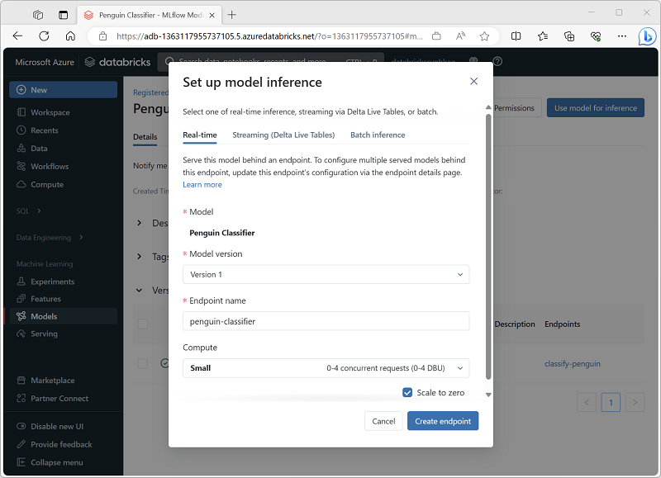
Using a model for inferencing
The process of using a model to predict labels from new feature data is known as inferencing.
You can use MLflow in Azure Databricks to make models available for inferencing in the following ways:
  Host the model as a real-time service with an HTTP endpoint to which client applications can make REST requests.
  Use the model to perform perpetual streaming inferencing of labels based on a delta table of features, writing the results to an output table.
  Use the model for batch inferencing based on a delta table, writing the results of each batch operation to a specific folder.
Notes:
https://learn.microsoft.com/en-us/training/modules/mlflow-azure-databricks/4-register-serve-models

Slide 13
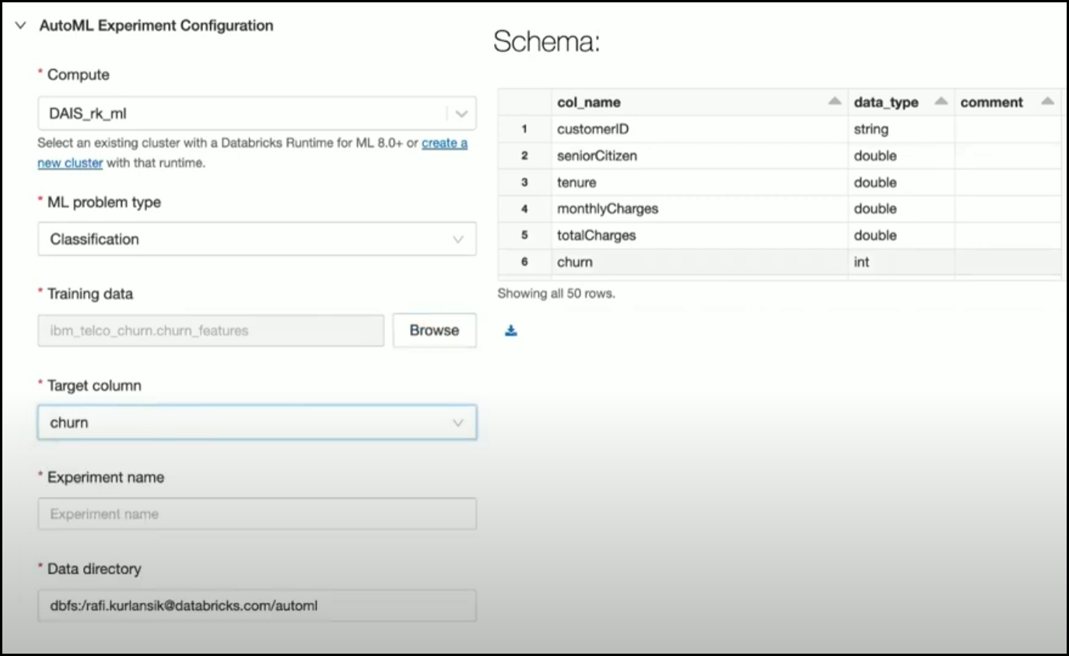
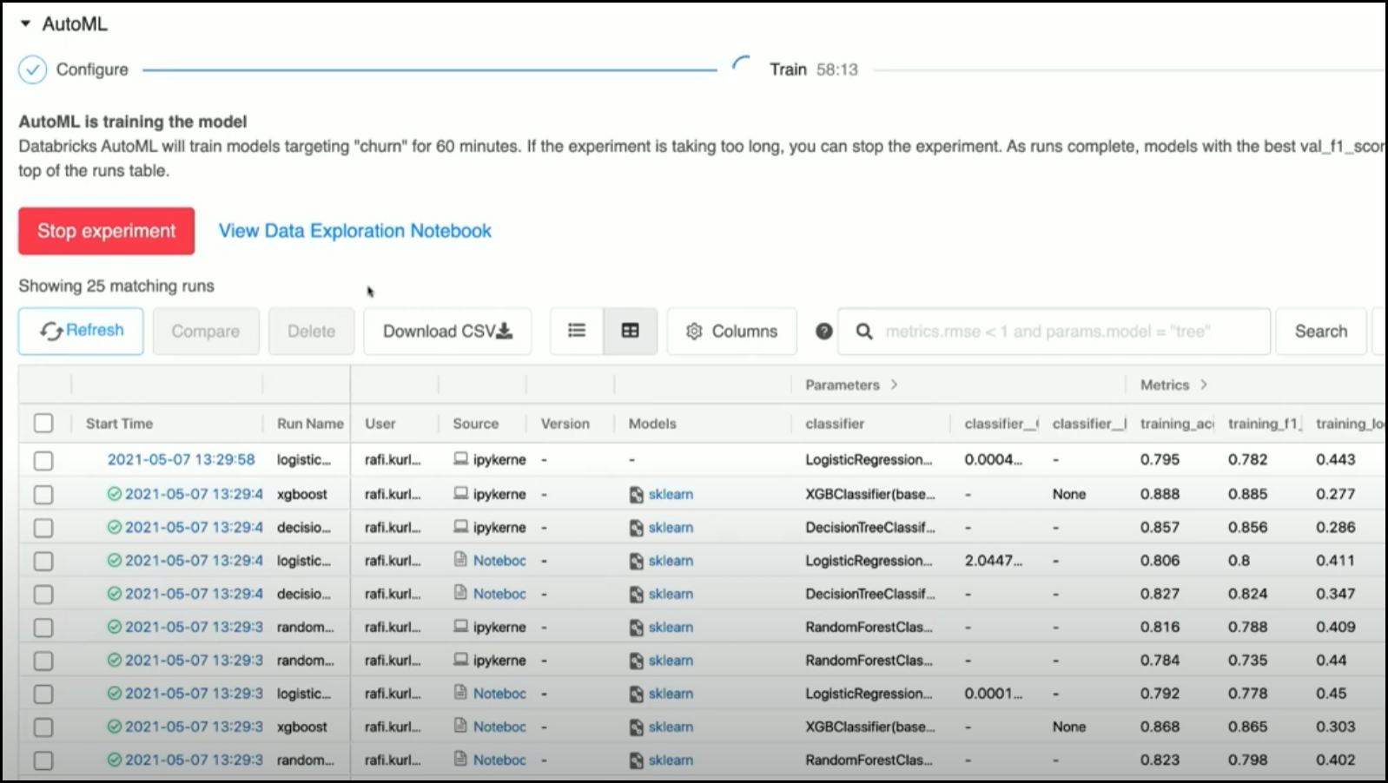
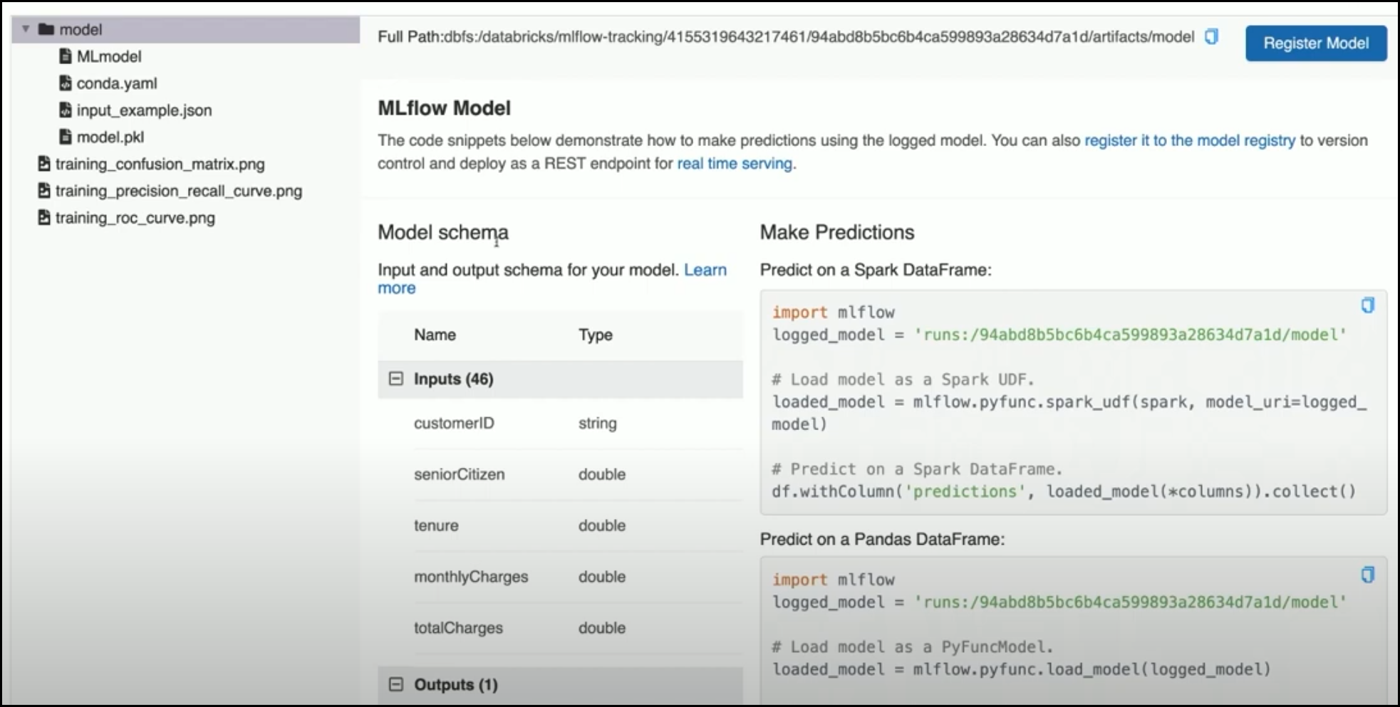

Slide 14
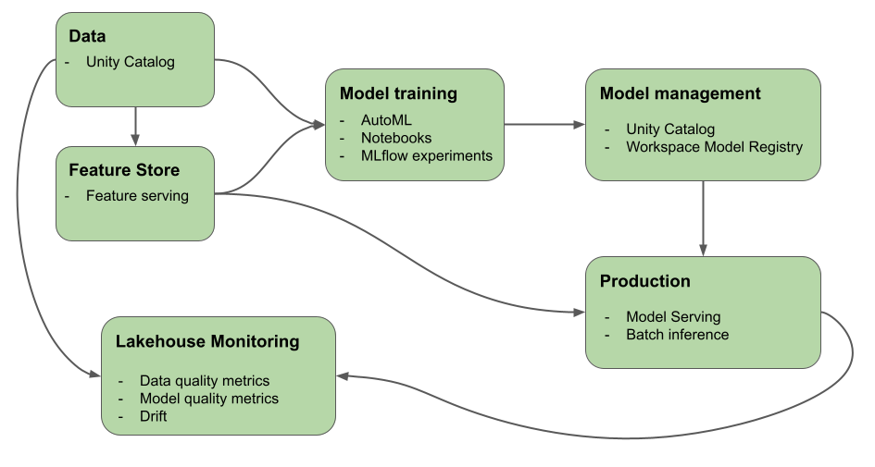
Databricks Mosaic AI
Mosaic AI (formerly Databricks Machine Learning) provides to help you build AI and ML systems.

Slide 15
Databricks-managed MLflow
Databricks-managed MLflow is built on Unity Catalog and the Cloud Data Lake to unify all your data and AI assets in the ML lifecycle:
  Feature store: Databricks automated feature lookups simplifies integration and reduces mistakes.
  Train models: Use Mosaic AI to train models or fine-tune foundation models.
  Tracking: MLflow tracks training by logging parameters, metrics, and artifacts to evaluate and compare model performance.
  Model Registry: MLflow Model Registry, integrated with Unity Catalog centralizes AI models and artifacts.
  Model Serving: Mosaic AI Model Serving deploys models to a REST API endpoint.
  Monitoring: Mosaic AI Model Serving automatically captures requests and responses to monitor and debug models. MLflow augments this data with trace data for each request.
Notes:
End to End Demo: https://www.youtube.com/watch?v=dQD2gVPJggQ

Slide 16
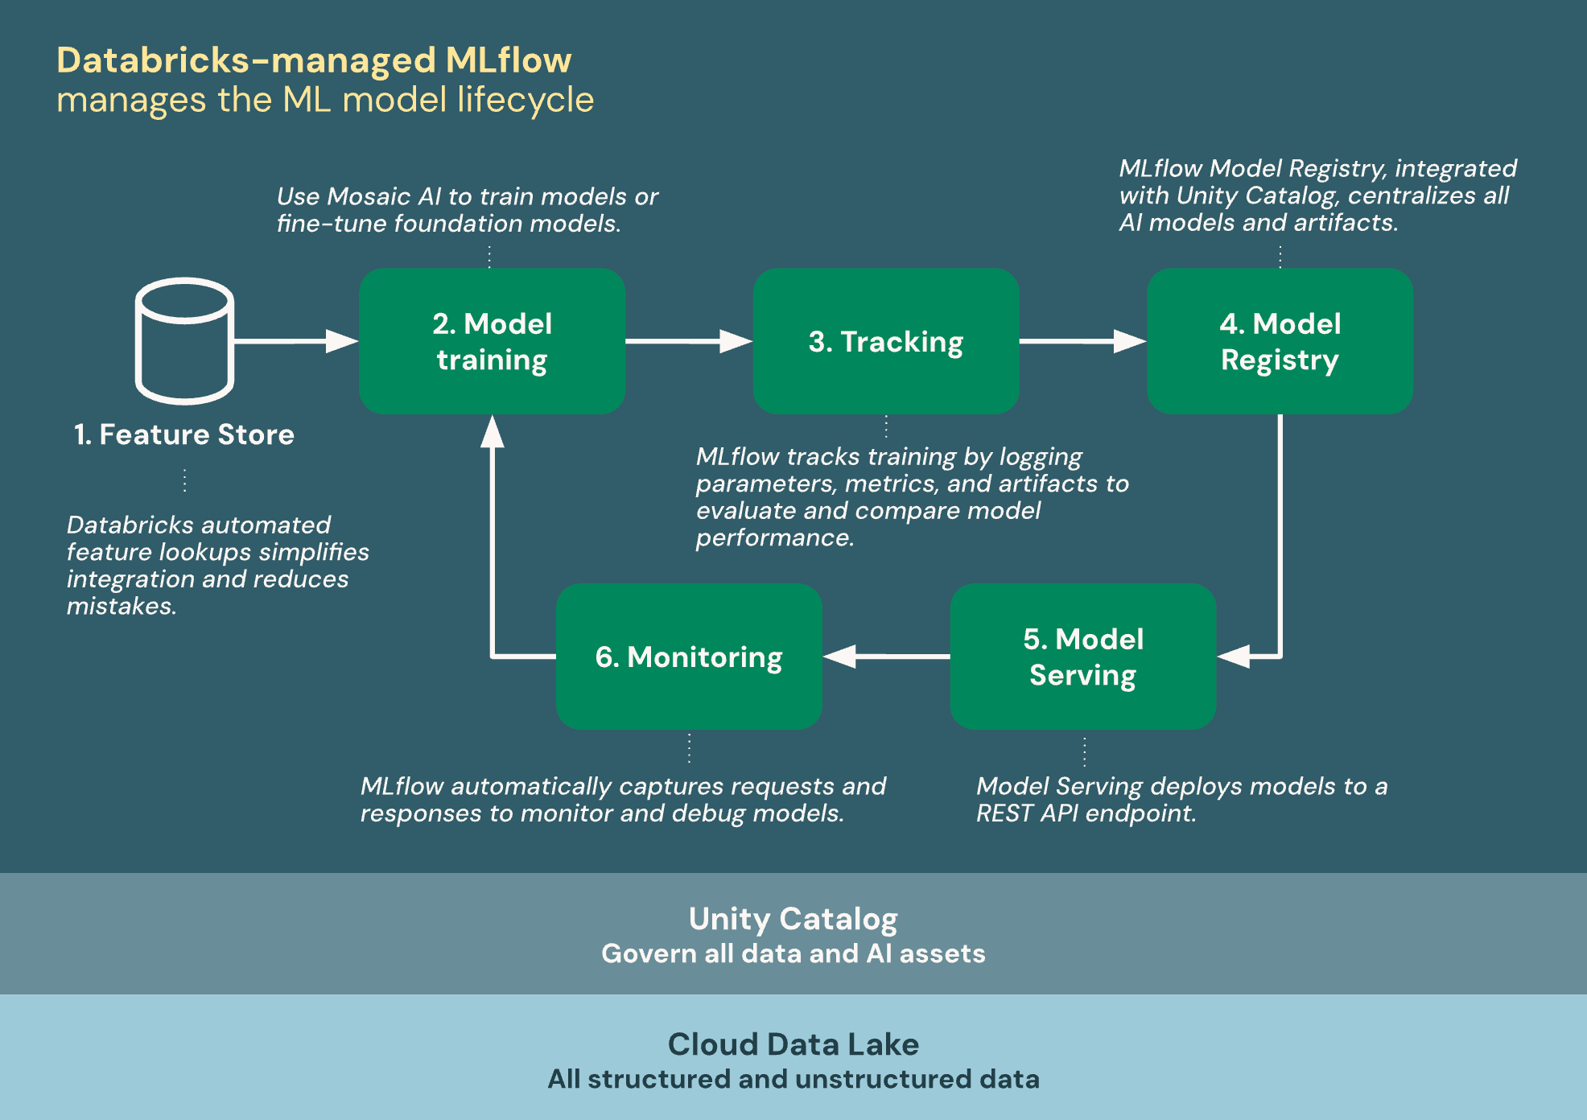
Databricks-managed MLflow

Slide 17
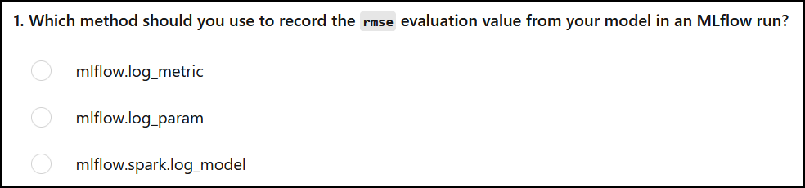
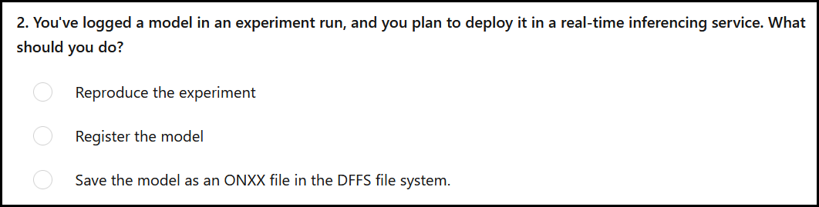
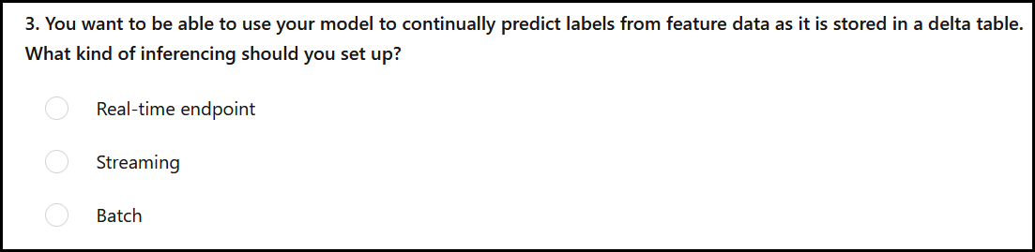
Module Assessment

Slide 18
Labs (Enable MLflow on DS05/06 Labs as well)
https://microsoftlearning.github.io/mslearn-databricks/Instructions/Exercises/DS-04-Use-MLflow.html
https://microsoftlearning.github.io/mslearn-databricks/Instructions/Exercises/DS-05-Use-AutoML.html
https://microsoftlearning.github.io/mslearn-databricks/Instructions/Exercises/DS-06-Tune-hyperparameters.html

